Slide 1
HOW DO ORGANISMS REPRODUCE?
CHAPTER 8
Part 1

Slide 2
Modes of Reproduction by Single Organisms

Slide 3
What is Reproduction?
It is a process of producing offspring.
Types:
Sexual Reproduction
Asexual Reproduction
Notes:
Reproduction is the process by which organisms, such as plants and animals, produce offspring.
In this process, organisms replicate themselves and bear offspring in order to ensure the survival of their species.
There are two types of reproduction namely Sexual Reproduction and Asexual Reproduction

Slide 4
Asexual Reproduction
A new organism is generated by only a single organism, i.e, the parent.
Examples are fungi, bacteria, etc.
Notes:
In asexual reproduction, a single organism generates a new organism.
This organism is genetically identical to its parent.
Organisms that partake in asexual reproduction include most fungi, bacteria and certain plants.

Slide 5
Types of Asexual Reproducition
The types of asexual reproduction are:
Fission
Fragmentation
Regeneration
Spore Formation
Vegetative Propogation
Budding
Notes:
Few types of asexual reproduction are Fission, Fragmentation, Regeneration, Spore Formation, Vegetative Propogation, and Budding. We shall briefly discuss about them in the upcoming slides.

Slide 6
Fission
The parent cell divides into two or more cells.
There are two types of fission:
Binary fission
Multiple Fission
Notes:
Fission means division.
During the fission process, the parent cell divides into two or more cells.
The orientation of the division is different or different cells.
Animate the displayed picture.
For example, as you can see in the diagram, an amoeba can divide itself into two at any plane but the division in Leishmania is longitudinal.
Fission can be of two types, namely, binary fission and multiple fission.

Slide 7
Fragmentation
In fragmentation, the parent body divides into two or more fragments.
Examples are planaria, spirogyra, etc.
Notes:
Fragmentation is nothing but another type of asexual reproduction.
Multi-cellular organisms like planaria, spirogyra, etc. reproduce by fragmentation.
Here, parent body divides into two or more fragments, and Later, each fragment develops into a new individual
Animate an appropriate diagram accordingly

Slide 8
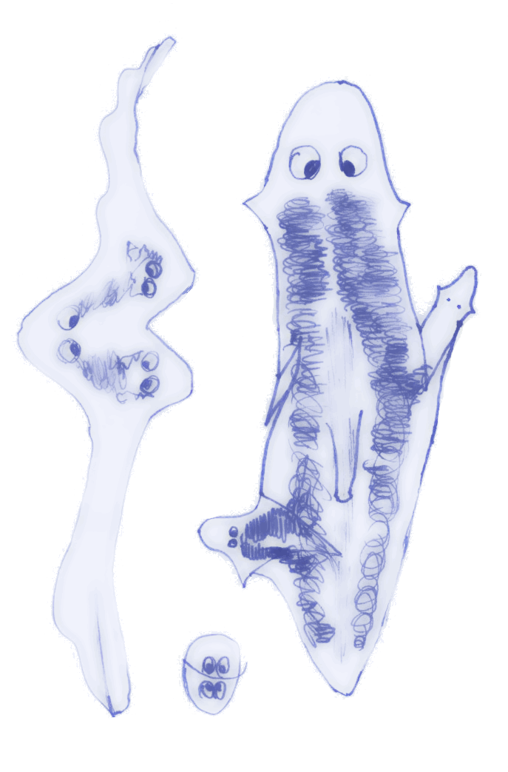
Regeneration
In regeneration, specialized cells can differentiate and grow into a new organism.
Examples are hydra, planaria, etc.
Notes:
Animate the displayed picture.
If you ever observed, When a lizard loses its tail, it grows a new one. This is nothing but regeneration.
In many organisms, there are specialized cells, which can differentiate and grow into a new organism.
Organisms like hydra and planaria and of course, lizards, also show regeneration.
In these organisms, when the cell divides into numerous pieces, each piece proliferates and differentiates to regenerate new organisms.

Slide 9
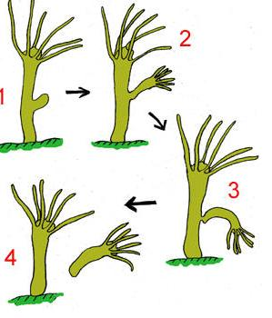
Budding
Reproduction through buds is called budding.
Example : Hydra
Notes:
Animate the displayed picture
Some organisms develop buds on their body. These buds develop into a new individual. This is known as budding.
An example is a hydra. From the parent hydra, a bud arises which eventually matures into a new hydra. Once it gets mature, it detaches from the parent body.

Slide 10
Vegetative Propagation
Vegetative propagation is nothing but reproduction through vegetative parts of the plants.
Exmaples :
Potato
Onion bulbs
Notes:
Plants reproduce asexually through their vegetative parts. The vegetative parts are nothing but leaves, roots, stem, and buds. This is known as vegetative propagation.
For example, onion bulbs, tubers of potato, runners/stolon, etc propogate through this method.
Vegetative Propagation is much faster than the sexual reproduction in plants, which we will be discussing in the later slides.
This can be done artificially as well, which is widely employed in horticulture.
Animate an appropriate diagram

Slide 11
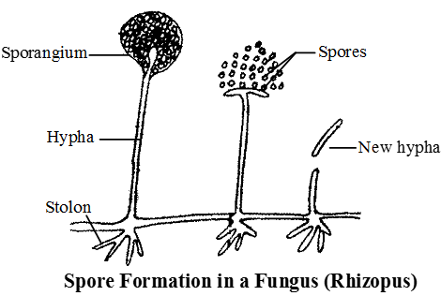
Spore Formation
Offsprings are generated from spores, produced by sporangium
Notes:
Spore formation is another means of asexual reproduction, and the last type of asexual reproduction we’ll be discussing about in this video.
A few Organisms which belong to the fungi group produce spores within a sac-like structure called sporangium.
Under the favorable conditions, sporangium burst to release spores which germinate to form new offspring.
Animate an appropriate diagram

Slide 12
Conclusion
What is Reproduction?
Modes of Reproduction by Single Organisms
Types of Asexual Reproduction

